Slide 1
MOVE, BAUSKA!
Rihards Žilionis, Annija Vītoliņa, Sofia Ogorodnikova, Dilobarhon Tojiboeva, Roberta Zvejniece, Emīls Kraģis, Kristiāna Jaunpetroviča

Slide 2

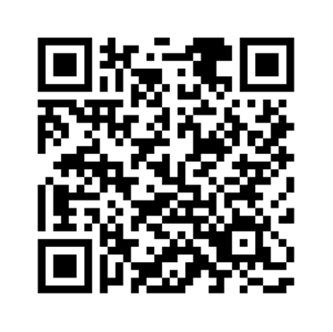
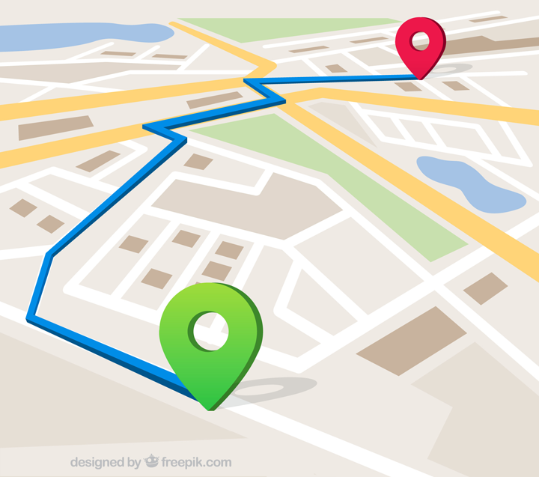
our project
We are creating a digitalised cycling/walking route with QR codes placed in the most popular sightseeing objects/attraction points that are in Bauskas centre. The QR codes will lead a tourist to a webpage that contains information about the sightseeing object where the QR was scanned, a picture, an implemented map with all the other atraction points and a task about the object which the tourists will be able to submit and see the correct answer afterwards.
Regarding the Unity Ride ideas then, it is something that is not in our plans anymore, as it is something that needs to be handled a lot differently, and is a completely different idea, which is why both are not combinable in this project.

Slide 3
plans initially
what we planned to achieve after the 1st project report:
Create a route containing the attraction points. Come up with the user tasks (small insight on the end product);
Understand how to connect and implement our webpage into Bauska’s tourism webpage;
Marketing plan (how to advertise our digitalised route);
Our website’s interface and functions;
Content of the website that comes from the QR codes.

Slide 4
stakeholders
the main stakeholders left in the «game»:
Bauska’s Information Centre/Bauska’s tourism webpage;
The Bauskas municipality;
Their problem is lack of tourism.
Tourists
Problem/ need- no interesting way how to explore Bauska. For tourists to do this route they will need to download a QR reader if it is not built in the phone (most phones that are new have this option).
At this point there are not many main stakeholders as many of them have been taken out of discussion because of the cancelation of the Latvian Cyclist Unity Ride – it is a big event with a lot of needs, which demands many important stakeholders.

Slide 5
results
what has been accomplished while exploring the problem and working on the product:
A route with 10 attraction points in Bauskas centre has been completed;
10 multiple choice user tasks about the sightseeing objects have been created;
Information about almost all the sightseeing objects/attraction points that will go into the QR code leading webpages have been created;
A digitalised, movable map with all points located has been made;
A proof of concept for the website. It can be accessed with a QR code that was generated. Also we have learned how to use DigitalOcean for hosting and Wordpress as a website creating platform.

Slide 6
our solution
what has been done to define our solution:
To define our solution we have done research/problem-solving, made conclusions, made and found all information necessary to create the digitalised route and come up with a concept and a prototype for the website and map that seems the most logical, user friendly, easy and functional.
our solution functions:
Our solution will give people a chance to explore Bauska in an active and digital way while gaining information about Bauskas most popular sightseeing objects and a little bit about Bauska’s history.

Slide 7
goal for November 22nd
our goal for November 22nd, our next iteration:
To showcase a prototype of our product;
Showcase the user experience- how the QR code is used and how it leads to a webpage with all the information and tasks;
Showcase the function of answers to tasks being saved;
Start on the design of the website.

Slide 8
next steps
First, we need to finish developing all the QR codes as well as the website that includes the information, pictures and tasks. Then we can start testing. One thing that we need to test is if the QR codes function. We will test the teams registration function. Furthermore, we need to finalise the ideas regarding advertising and how we can implement the QR codes in their respective places. Need to contact «Būvvalde», information centre or any other respective personnel that can help us with this task. Overall, we need to start putting all the details together to see how they cooperate.
Help - At the moment there is not anything specific that we need help with; however, help might be needed when testing will start. Some additional IT side development questions might also occur.

